Slide 1
Mining

Slide 2
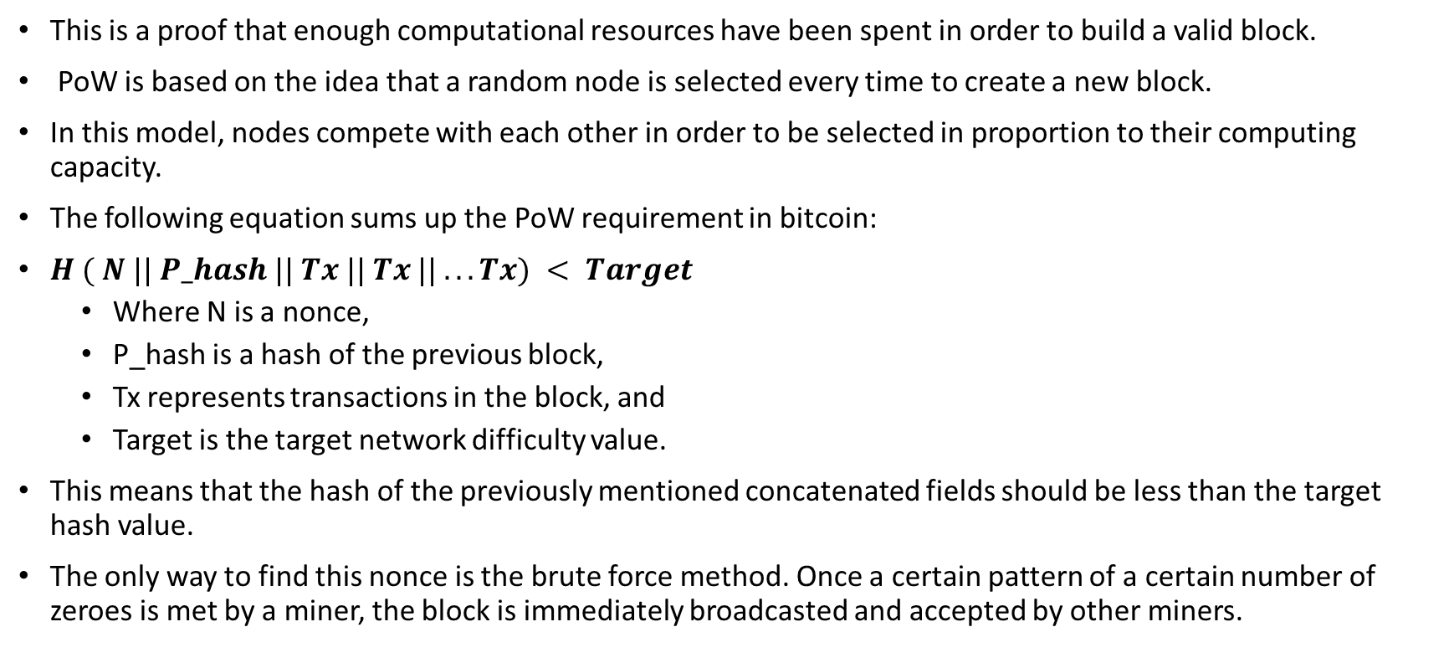
Proof of Work (PoW)
This is a proof that enough computational resources have been spent in order to build a valid block.
PoW is based on the idea that a random node is selected every time to create a new block.
In this model, nodes compete with each other in order to be selected in proportion to their computing capacity.
The following equation sums up the PoW requirement in bitcoin:
$H ( N || P_hash || Tx || Tx || . . . Tx) < Target$
Where N is a nonce,
P_hash is a hash of the previous block,
Tx represents transactions in the block, and
Target is the target network difficulty value.
This means that the hash of the previously mentioned concatenated fields should be less than the target hash value.
The only way to find this nonce is the brute force method. Once a certain pattern of a certain number of zeroes is met by a miner, the block is immediately broadcasted and accepted by other miners.

Slide 3
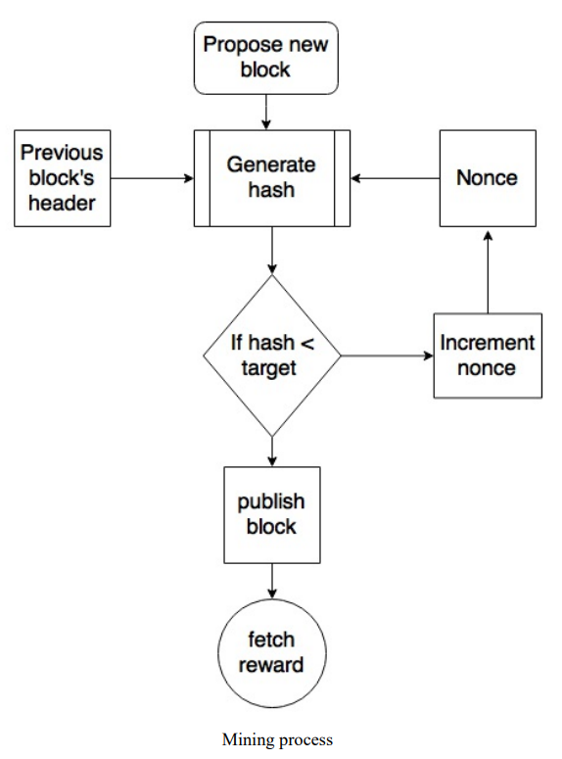
The mining algorithm
The mining algorithm consists of the following steps.
The previous block's header is retrieved from the bitcoin network.
Assemble a set of transactions broadcasted on the network into a block to be proposed.
Compute the double hash of the previous block's header combined with a nonce and the newly proposed block using the SHA-256 algorithm.
Check if the resultant hash is lower than the current difficulty level (target) then PoW is solved. As a result of successful PoW the discovered block is broadcasted to the network and miners fetch the reward.
If the resultant hash is not less than the current difficulty level (target), then repeat the process after incrementing the nonce.

Slide 4
Mining difficulty
Mining difficulty increased over time and bitcoins that could be mined by single CPU laptop computers now require dedicated mining centers to solve the hash puzzle. The current difficulty level can be queried using the
Bitcoin command-line interface using the following command:
$ bitcoin-cli getdifficulty
1452839779145
This number represents the difficulty level of the Bitcoin network.
Miners compete to find a solution to a problem. This number, in fact shows, that how difficult it is to find a hash which is lower than the network difficulty target.
All successfully mined blocks must contain a hash that is less than this target number.
This number is updated every 2 weeks or 2016 blocks to ensure that on average 10-minute block generation time is maintained.

Slide 5
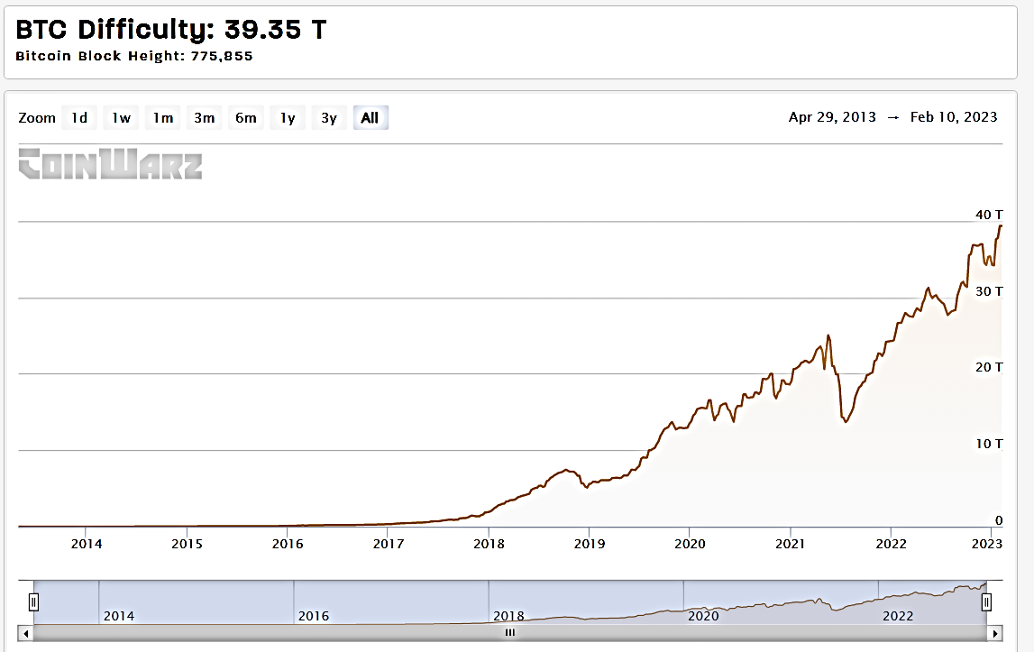
Mining difficulty
The reason why mining difficulty increases is because in Bitcoin, the block generation time has to be always around 10 minutes.
This means that if blocks are being mined too quickly by fast hardware then the difficulty increases so that the block generation time can remain at roughly 10 minutes per block.
This is also true in reverse if blocks are not mined every 10 minutes than the difficulty is decreased.
Difficulty, is calculated every 2016 blocks (in two weeks) and adjusted accordingly.
If the previous set of 2016 blocks were mined in less than a period of two weeks then difficulty will be increased.
Similarly, if 2016 blocks were found in more than two weeks (If blocks are mined every 10 minutes then 2016 blocks take 2 weeks to be mined) then the difficulty is decreased.

Slide 6
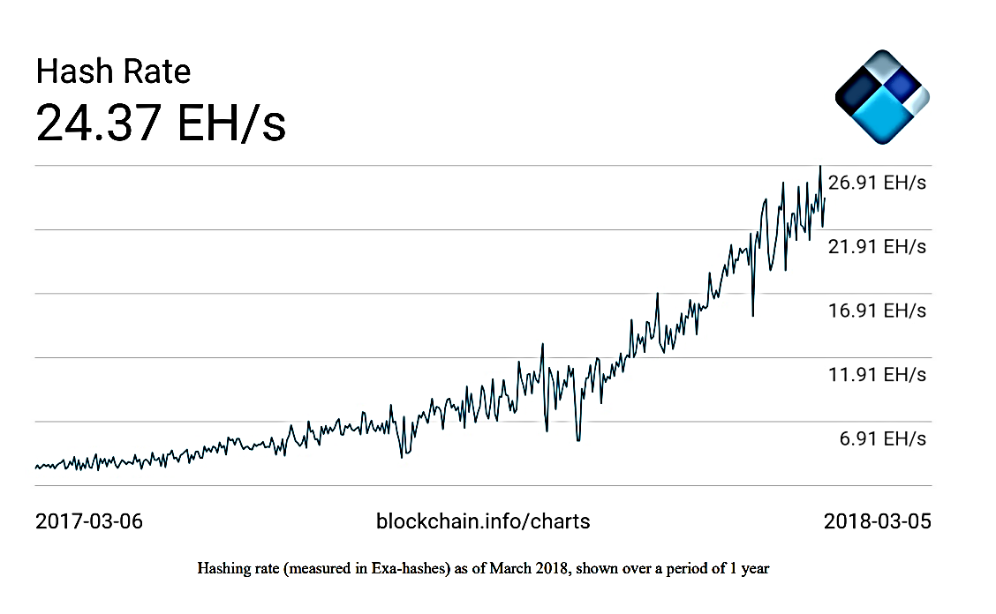
The Hash Rate
The hashing rate basically represents the rate of calculating hashes per second. In other words, this is the speed at which miners in the Bitcoin network are calculating hashes to find a block.
In early days of bitcoin, it used to be quite small as CPUs were used. However, with dedicated mining pools and ASICs now, this has gone up exponentially in the last few years. This has resulted in increased difficulty of the Bitcoin network.
In 1 second, the Bitcoin network miners are computing more than 24,000,000,000,000,000,000 hashes per second.

Slide 7
Mining systems
Mining systems
CPU
GPU
ASIC
FPGA

Slide 8
Mining pools
A mining pool forms when group of miners work together to mine a block. The pool manager receives the transaction if the block is successfully mined, which is then responsible for distributing the reward to the group of miners who invested resources to mine the block.
This is profitable as compared to solo mining, where only one sole miner is trying to solve the partial hash inversion function (hash puzzle) because, in mining pools, the reward is paid to each member of the pool regardless of whether they (more specifically, their individual node) solved the puzzle or not.
There are various models that a mining pool manager can use to pay to the miners
Pay Per Share (PPS) model: the mining pool manager pays a flat fee to all miners who participated in the mining exercise
proportional model: The share is calculated based on the amount of computing resources spent to solve the hash puzzle.

Slide 9
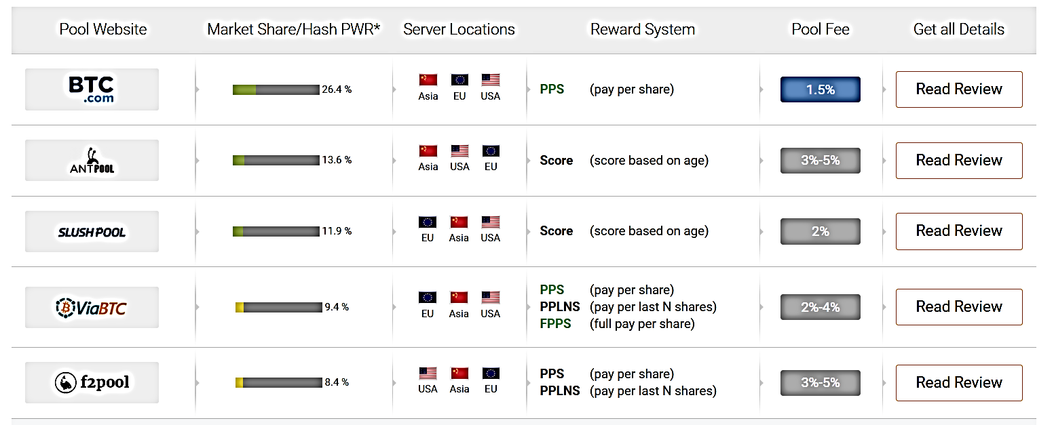
Bitcoin Mining Pools

Slide 10
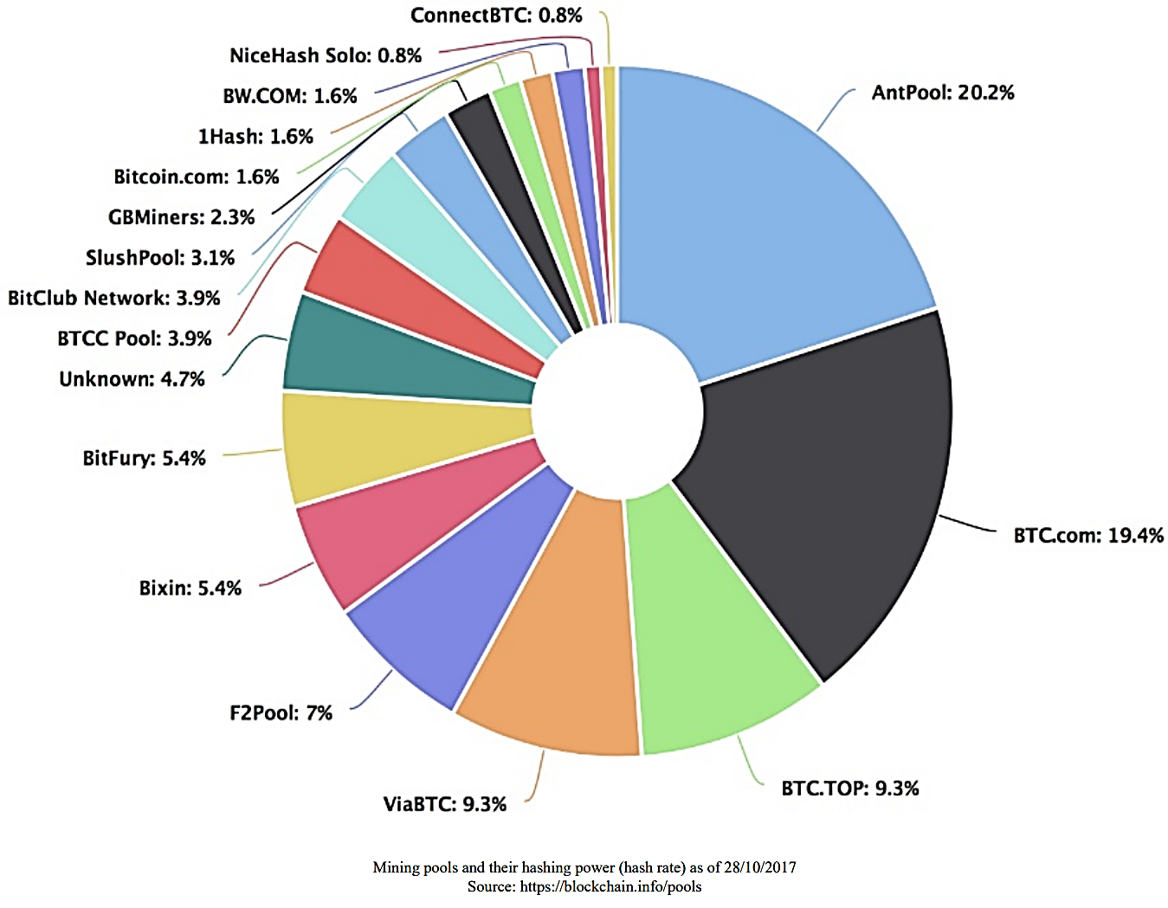

Slide 11
Bitcoin’s difficulty level is the estimated number of hashes required to mine a block.
The purpose of difficulty is to keep the rate of coin issuance and block confirmation intervals steady over time. The difficulty target also enforces protocol rules.

